Slide 1

Time Series

Slide 2
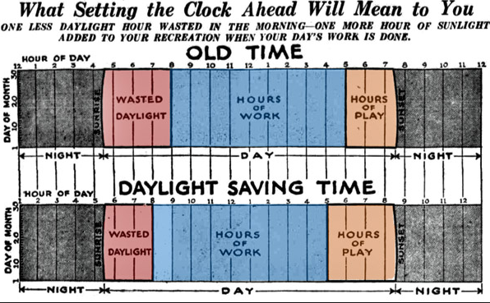

Slide 3
70% of business data
Notes:
Estimated that 70% of business data is time series. (Few, 2007) find actual research to cite for this!!

Slide 4
Time Series Data Properties
Discrete vs. interval
Linear vs. cyclical
Ordinal vs. continuous
Ordered vs. branching vs. multiple perspectives
Notes:
Cite Muller and Schumann 2003, from Frank, 1998 from Stasko slide

Slide 5
Characteristics of Change
Notes:
Few identifies several characteristics of change for time series data.
https://www.perceptualedge.com/articles/visual_business_intelligence/visualizing_change.pdf

Slide 6
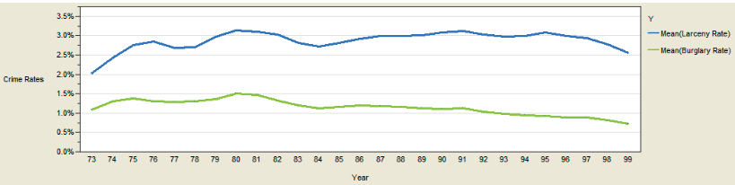
Magnitude
Chart source: Few, 2007. Visualizing change.

Slide 7
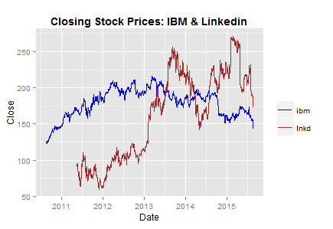
Shape
Chart source: https://www.r-bloggers.com/plotting-time-series-in-r-using-yahoo-finance-data/
Notes:
https://www.r-bloggers.com/plotting-time-series-in-r-using-yahoo-finance-data/

Slide 8
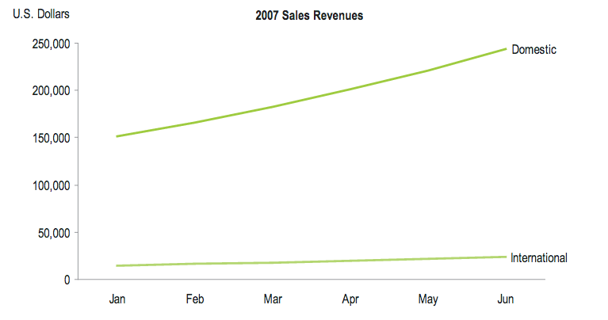
Velocity
Chart source: Few, 2007. Visualizing change.

Slide 9
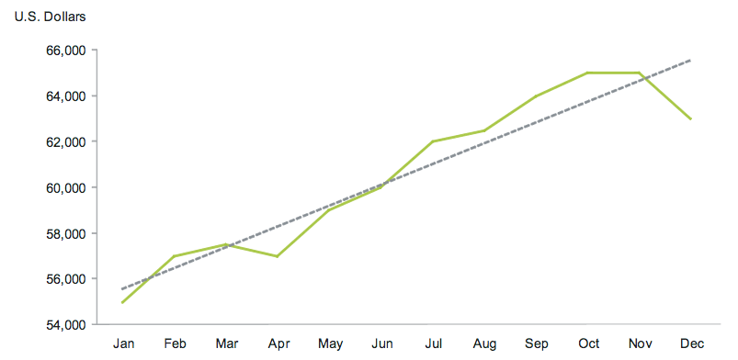
Direction
Chart source: Few, 2007. Visualizing change.

Slide 10
Motion
Notes:
Add Image

Slide 11
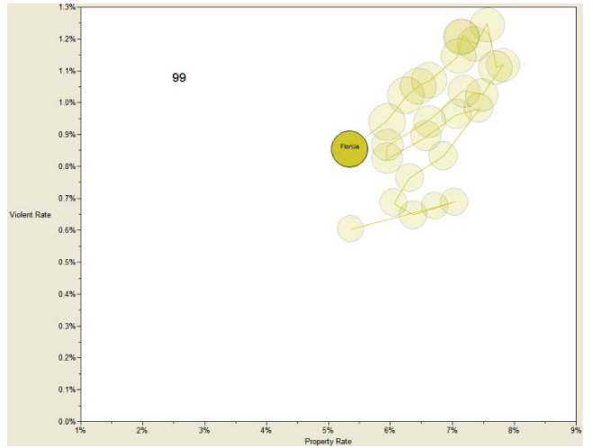
Chart source: Few, 2007. Visualizing change.

Slide 12
Linear

Slide 13
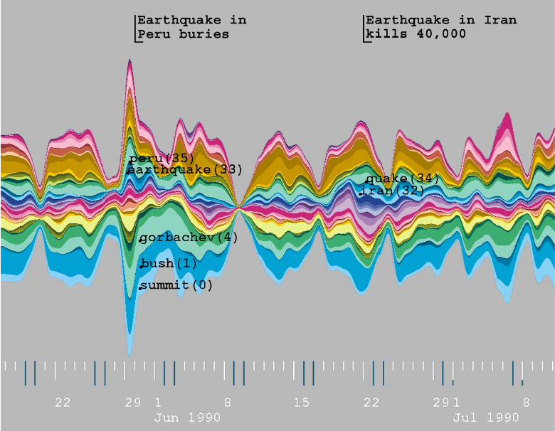
Chart source: Havre et al., 2000. ThemeRiver: Visualizing theme changes over time.
Notes:
Themeriver

Slide 14
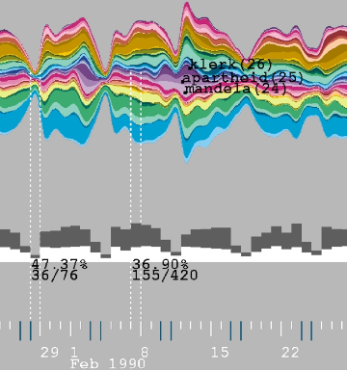
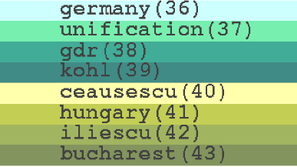
Chart source: Havre et al., 2000. ThemeRiver: Visualizing theme changes over time.
Notes:
http://www.ifs.tuwien.ac.at/~silvia/wien/vu-infovis/references/havre-ieeeinfovis00.pdf

Slide 15
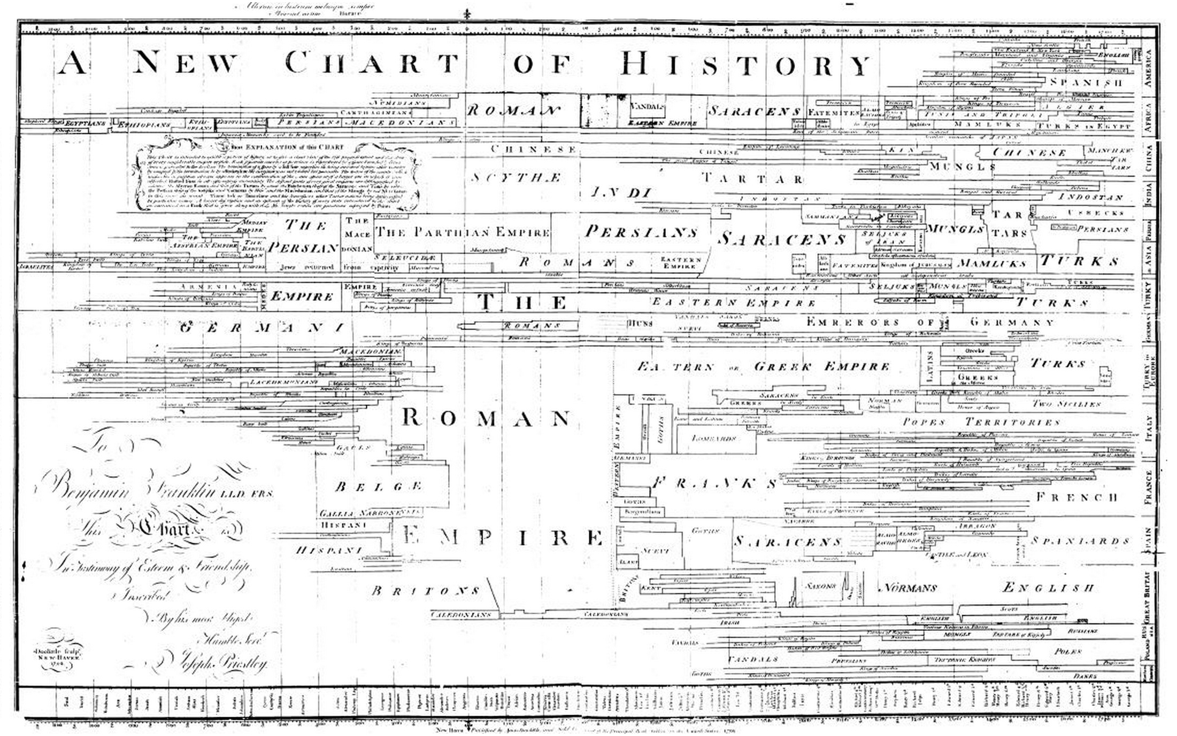
Joseph Priestly

Slide 16
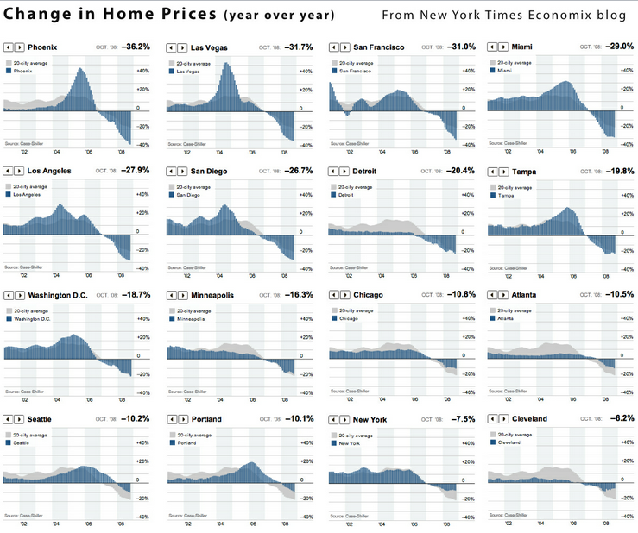
feed://evalcentral.com/feed/

Slide 17
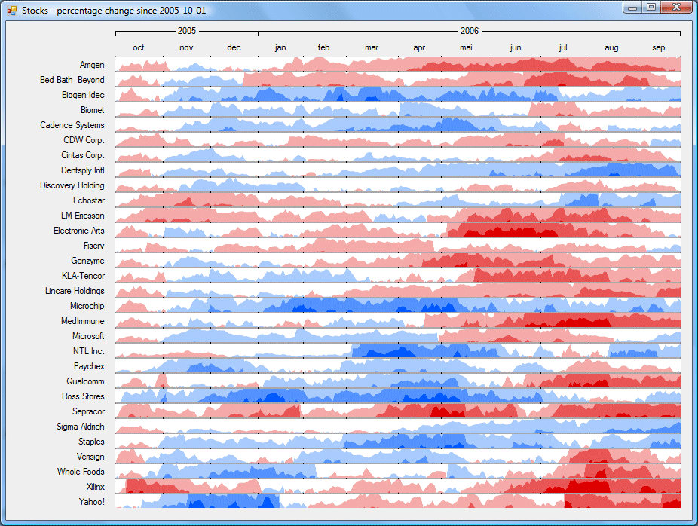
http://panopticon2.moneycoach.biz/assets/img/screenshot_horizongraph_large.gif

Slide 18
Cyclical

Slide 19
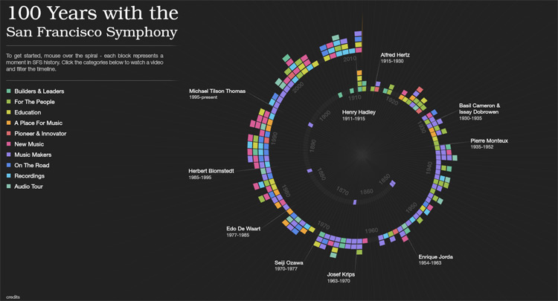
http://thewhyaxis.info/content/13-music/music-in1.jpg

Slide 20
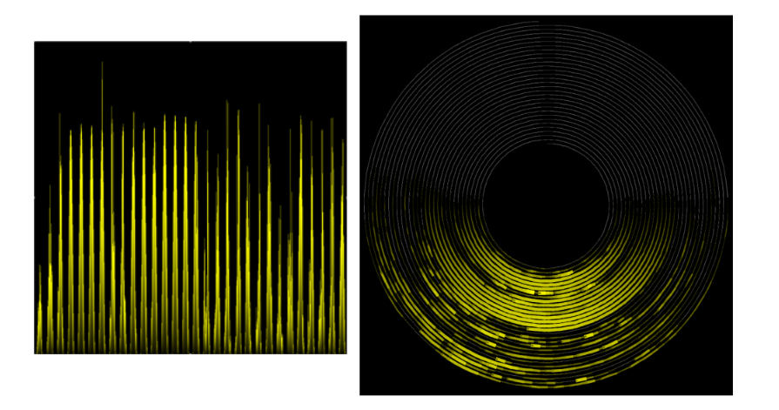
Diagram source: Weber, M., Alexa, M., & Müller, W. (2001, October). Visualizing time-series on spirals. In Infovis (Vol. 1, pp. 7-14).
Notes:
http://ieg.ifs.tuwien.ac.at/~aigner/teaching/ws06/infovis_ue/papers/spiralgraph_weber01visualizing.pdf

Slide 21
Events

Slide 22
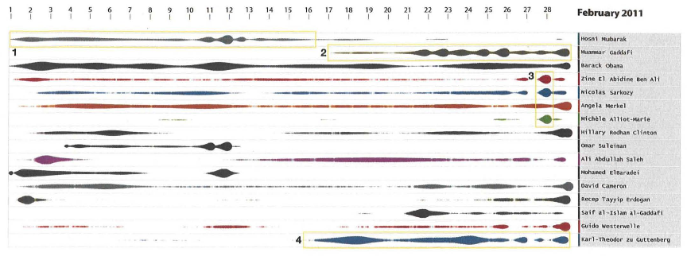
Chart source: Krstajic et al., 2011. CloudLines: Compact display of event episodes in multiple time series.
Notes:
https://kops.uni-konstanz.de/bitstream/handle/123456789/17483/Keim.pdf?sequence=1&isAllowed=y

Slide 23
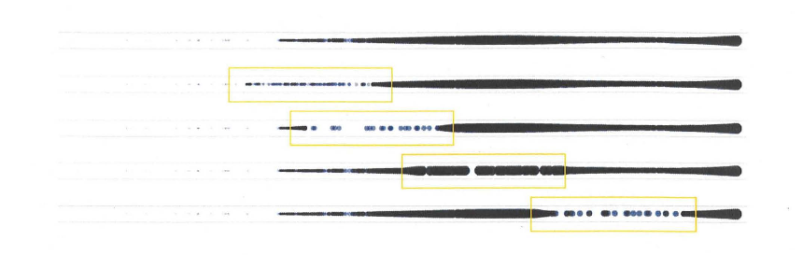
Chart source: Krstajic et al., 2011. CloudLines: Compact display of event episodes in multiple time series.
Notes:
https://kops.uni-konstanz.de/bitstream/handle/123456789/17483/Keim.pdf?sequence=1&isAllowed=y

Slide 24
Time Analytic Algorithms

Slide 25
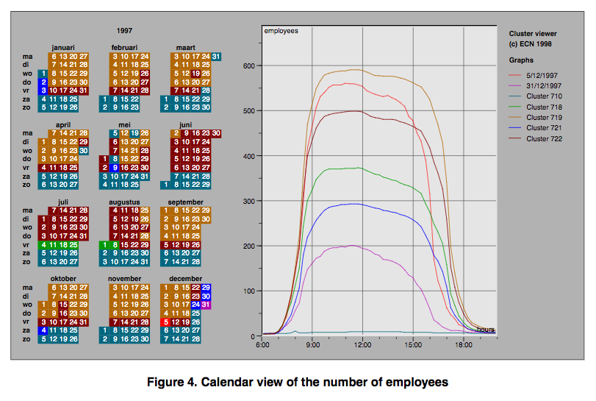
Clustering
Van Wijk & Selow, 1999
Notes:
http://www.cs.ubc.ca/~tmm/courses/cpsc533c-06-fall/readings/vanwijk99cluster.pdf

Slide 26
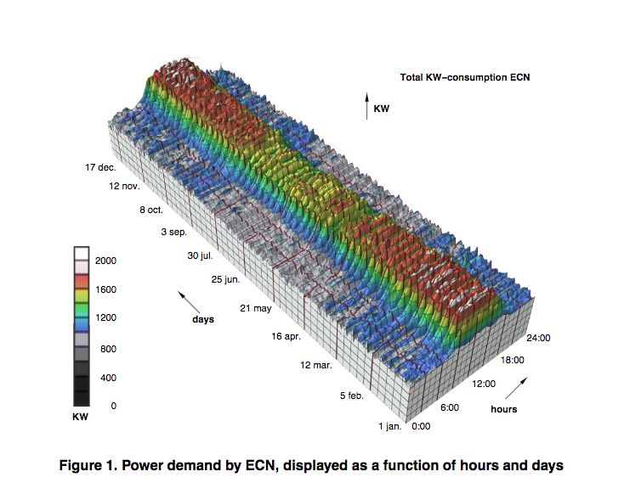
Clustering
Van Wijk & Selow, 1999
Notes:
http://www.cs.ubc.ca/~tmm/courses/cpsc533c-06-fall/readings/vanwijk99cluster.pdf

Slide 27
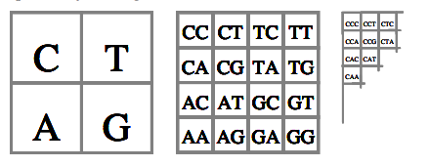
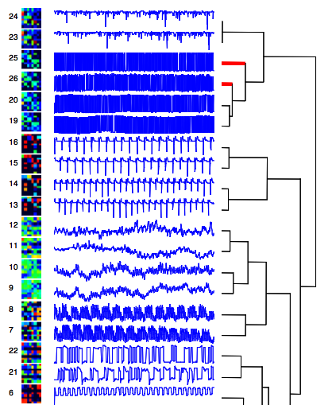
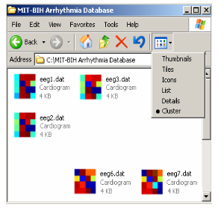
Time Series Bitmaps
Kumar et al., 2005
Notes:
http://citeseerx.ist.psu.edu/viewdoc/download?doi=10.1.1.413.4650&rep=rep1&type=pdf

Slide 28


